Slide 1
Class 13
Multi-Market Analysis by
Alan V. Deardorff
University of Michigan
2020
PubPol/Econ 541

Slide 2
Outline
Large country tariff
Differentiated-Product Import, Small Country
Import Input to Production of Final Good
Tariff on Imports from One Country but Not Another

Slide 3
Recall: Small-Country Tariff
Domestic Market
P ^{D}
S^{D}(P^{D})
Welfare Effects of Tariff:
Dom sup’s +a
Dom dem’s –(a+b+c+d)
Dom gov’t +c
Dom cty –(b+d)
(1+t)P^{W}
a
c
b
d
P^{W}
D^{D}(P^{D})
$$S_{0}^{D}$$
$$S_{1}^{D}$$
$$D_{1}^{D}$$
$$D_{0}^{D}$$
$$Q_{}^{D}$$
Figure 1
Tariff in a Small Country on a Homogeneous Good

Slide 4
Outline
Large country tariff
Differentiated-Product Import, Small Country
Import Input to Production of Final Good
Tariff on Imports from One Country but Not Another

Slide 5
Recall: Large-Country Tariff
Domestic Market
Foreign Market
P^{D}
P^{F}
S^{D}(P^{D})
D^{F}(P^{F})
S^{F}(P^{F})
$${\left(1+t)P\right.}_{1}^{W}$$
a
b
c
d
$$P_{0}^{W}$$
$$P_{0}^{W}$$
e
f
g
h
i
$$P_{1}^{W}$$
$$P_{1}^{W}$$
D^{D}(P^{D})
$$S_{0}^{D}$$
$$S_{1}^{D}$$
$$D_{1}^{D}$$
$$D_{0}^{D}$$
$$Q_{}^{D}$$
$$D_{0}^{F}$$
$$D_{1}^{F}$$
$$S_{1}^{F}$$
$$S_{0}^{F}$$
$$Q_{}^{F}$$
Welfare Effects of Tariff:
Dom sup’s +a
Dom dem’s –(a+b+c+d)
Dom gov’t +(c+e)
Dom cty +e–(b+d)
For sup’s –(f+g+h+i)
For dem’s +f
For gov’t 0
For cty –(g+h+i)
World –(b+d+g+i)
This was a multi-market analysis
Figure 2
Tariff in a Large Country (“Domestic”) on a Homogeneous Good

Slide 6
Pause for Discussion

Slide 7
  Questions
[In the Deardorff reading] There is an error in the sentence immediately following Figure 2. What is it? And why is the corrected sentence then correct?

Slide 8
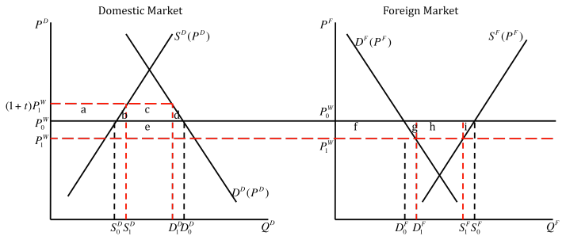

Slide 9
  Questions
In the case of a large-country tariff, what would a graph of the welfare of the tariff-levying country look like as a function of the size of the tariff?

Slide 10
Outline
Large country tariff
Differentiated-Product Import, Small Country
Import Input to Production of Final Good
Tariff on Imports from One Country but Not Another

Slide 11
Differentiated-Product Import, Small Country
Domestic Good
Import
P^{D}
P^{M}
$$S^{D}\left(P^{D}\right)$$
Horizontal for small country
$$P_{0}^{D}$$
$$P_{0}^{M}$$
$$S_{}^{M}$$
$$D^{M}\left(P^{M},P_{0}^{D}\right)$$
$$D^{D}\left(P^{D},P_{0}^{M}\right)$$
$$Q_{}^{D}$$
$$Q_{}^{M}$$
Both demands depend on both prices
Figure 4
Tariff on Imported Imperfect Substitute for Domestic Good

Slide 12
Differentiated-Product Import, Small Country
Domestic Good
Import
P^{D}
P^{M}
$$S^{D}\left(P^{D}\right)$$
$$P_{1}^{D}$$
b
a
b
$$\left.P_{1}^{M}=(1+t\right)P_{0}^{M}$$
f
c
d
h
$$P_{0}^{D}$$
e
g
$$P_{0}^{M}$$
$$S_{}^{M}$$
$$D^{M}\left(P^{M},P_{1}^{D}\right)$$
$$D^{D}\left(P^{D},P_{1}^{M}\right)$$
$$D^{M}\left(P^{M},P_{0}^{D}\right)$$
$$D^{D}\left(P^{D},P_{0}^{M}\right)$$
$$Q_{}^{D}$$
$$Q_{}^{M}$$
Welfare Effects of Tariff:
Dom sup’s +(a+b)
Dom dem’s –(a+b+c+d)
& –(e+g)
Dom gov’t +(e+f)
Dom cty –(c+d+g–f)
But (c+d) = (f+h)
(Why? Trust me.)
So
Dom cty –(f+h+g–f)
= – (h+g)
Figure 4
Tariff on Imported Imperfect Substitute for Domestic Good

Slide 13
Differentiated-Product Import, Small Country
Domestic Good
Import
P^{D}
P^{M}
$$S^{D}\left(P^{D}\right)$$
$$P_{1}^{D}$$
a
b
$$\left.P_{1}^{M}=(1+t\right)P_{0}^{M}$$
f
c
d
h
$$P_{0}^{D}$$
e
g
$$P_{0}^{M}$$
$$S_{}^{M}$$
$$D^{M}\left(P^{M},P_{1}^{D}\right)$$
$$D^{D}\left(P^{D},P_{1}^{M}\right)$$
$$D^{M}\left(P^{M},P_{0}^{D}\right)$$
$$D^{D}\left(P^{D},P_{0}^{M}\right)$$
$$D^{M}\left(P^{M},P^{D}(P^{M})\right)$$
$$Q_{}^{D}$$
$$Q_{}^{M}$$
$$D^{M}\left(P^{M},P_{0}^{D}\right)$$
Is “ceteris paribus” demand curve
Welfare Effects of Tariff:
Dom sup’s +(a+b)
Dom dem’s –(a+b+c+d)
& –(e+g)
Dom gov’t +(e+f)
Dom cty –(c+d+g–f)
But (c+d) = (f+h)
(Why? Trust me.)
So
Dom cty –(f+h+g–f)
= – (h+g)
$$D^{M}\left(P^{M},P^{D}(P^{M})\right)$$
Is “mutatis mutandis” demand curve
Figure 4
Tariff on Imported Imperfect Substitute for Domestic Good

Slide 14
Differentiated-Product Import, Small Country
Bottom line:
  You can correctly analyze a tariff on an differentiated import if you
    Use just the market for it
    With “mutatis mutandis” import demand curve
      That is, one that does not hold the domestic price constant
      But rather allows that price to change in response to the change in price of import
    This will not, however, tell you what happens to
      Price and quantities of the domestic good

Slide 15
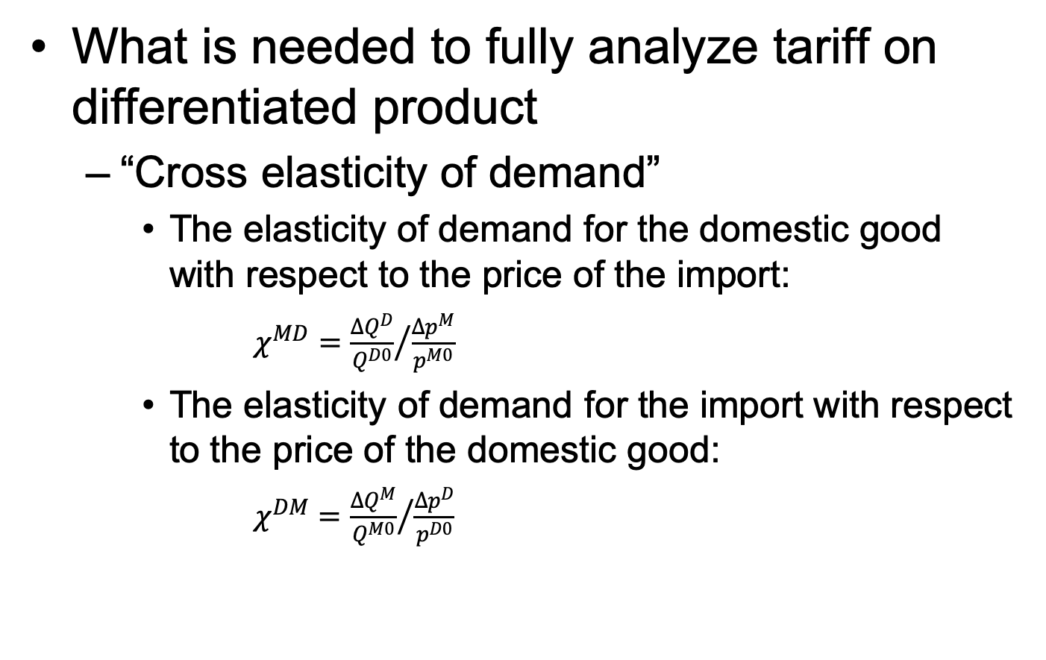
Differentiated-Product Import, Small Country
What is needed to fully analyze tariff on differentiated product
  “Cross elasticity of demand”
    The elasticity of demand for the domestic good with respect to the price of the import:
      $χ^{MD}={\frac{{∆Q}^{D}}{Q^{D0}}}/{\frac{{∆p}^{M}}{p^{M0}}}$
    The elasticity of demand for the import with respect to the price of the domestic good:
      $χ^{DM}={\frac{{∆Q}^{M}}{Q^{M0}}}/{\frac{{∆p}^{D}}{p^{D0}}}$

Slide 16
Differentiated-Product Import, Small Country
Cross elasticities
  These will both be positive if the goods are substitutes
    As they will be for differentiated products
    Larger cross elasticity means closer substitutes
  They would be both negative if the goods were complements, such as different products that are typically used together (e.g., bread and butter, wine and cheese, cars and gasoline)
  These are even harder to find out values for than (own) supply and demand elasticities

Slide 17
Pause for Discussion

Slide 18
  Questions
If a country does not produce a good that is identical to something that it imports, does it follow that there would be no interest in levying a tariff on those imports?
How does the effect of a tariff in a small country differ depending on whether the import is identical to the domestic good or it is differentiated?

Slide 19
Outline
Large country tariff
Differentiated-Product Import, Small Country
Import of Input to Production of Final Good
Tariff on Imports from One Country but Not Another

Slide 20

Tariff on Input to Production of
Traded Final Good
Final Good
Imported Input
P^{F}
P^{I}
Supply of final good and demand for input both depend on both prices
$$S^{F}\left(P^{F},P_{0}^{I}\right)$$
$$P_{0}^{F}$$
$$P_{0}^{I}$$
$$S_{}^{M}$$
$$D^{F}\left(P^{F}\right)$$
$$D^{I}\left(P^{I},P_{0}^{F}\right)$$
$$Q_{0}^{F}$$
$$Q_{}^{F}$$
$$Q_{0}^{I}$$
$$Q_{}^{I}$$
Small country again, and both goods traded, so prices fixed in world market
Note: In this case the position of DF does not matter, since PF does not change. Final good may be imported or exported.
Note: In my paper I have input demand depend on quantity, not price
Figure 5
Tariff on Imported Input to Traded Final Good Production

Slide 21
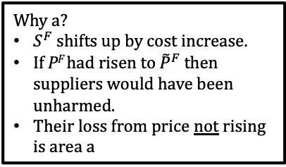
Tariff on Input to Production of
Traded Final Good
Final Good
Imported Input
P^{F}
$$S^{F}\left(P^{F},P_{1}^{I}\right)$$
P^{I}
$$S^{F}\left(P^{F},P_{0}^{I}\right)$$
$${\tilde{P}}^{F}$$
a
$$\left.P_{1}^{I}=(1+t\right)P_{0}^{I}$$
$$P_{0}^{F}$$
b
c
$$P_{0}^{I}$$
$$S_{}^{M}$$
$$D^{F}\left(P^{F}\right)$$
$$D^{I}\left(P^{I},P_{1}^{F}\right)$$
$$Q_{1}^{F}$$
$$Q_{0}^{F}$$
$$Q_{}^{F}$$
$$Q_{1}^{I}$$
$$Q_{0}^{I}$$
$$Q_{}^{I}$$
Why a?
$S^{F}$ shifts up by cost increase.
If P^{F} had risen to ${\tilde{P}}^{F}$ then suppliers would have been unharmed.
Their loss from price not rising is area a
Welfare Effects of Input Tariff
Dom sup’s lose –a = –(b+c)
Dom dem’s unhurt 0
Dom gov’t +b
Dom cty –c
Figure 5
Tariff on Imported Input to Traded Final Good Production

Slide 22
Tariff on Input to Production of
Non-Traded Final Good
Final Good
Imported Input
P^{F}
P^{I}
$$S^{F}\left(P^{F},P_{0}^{I}\right)$$
$$P_{0}^{F}$$
$$P_{0}^{I}$$
$$S_{}^{M}$$
$$D^{F}\left(P^{F}\right)$$
$$D^{I}\left(P^{I},P_{0}^{F}\right)$$
$$Q_{0}^{F}$$
$$Q_{}^{F}$$
$$Q_{0}^{I}$$
$$Q_{}^{I}$$
Figure 5
Tariff on Imported Input to Production of Non-traded Final Good

Slide 23




Tariff on Input to Production of
Non-Traded Final Good
Final Good
Imported Input
P^{F}
$$S^{F}\left(P^{F},P_{1}^{I}\right)$$
P^{I}
$$D^{I}\left(P^{I},\text{P}\text{F} (P^{I})\right)$$
$$S^{F}\left(P^{F},P_{0}^{I}\right)$$
$$P_{1}^{F}$$
$$\left.P_{1}^{I}=(1+t\right)P_{0}^{I}$$
$$P_{0}^{F}$$
$$P_{0}^{I}$$
$$S_{}^{M}$$
$$D^{I}\left(P^{I},P_{1}^{F}\right)$$
$$D^{F}\left(P^{F}\right)$$
$$D^{I}\left(P^{I},P_{0}^{F}\right)$$
$$Q_{1}^{F}$$
$$Q_{0}^{F}$$
$$Q_{}^{F}$$
$$Q_{1}^{I}$$
$$Q_{}^{I}$$
$$Q_{0}^{I}$$
Figure 5
Tariff on Imported Input to Production of Non-traded Final Good

Slide 24
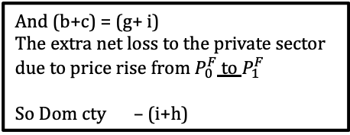
Tariff on Input to Production of
Non-Traded Final Good
Final Good
Imported Input
P^{F}
$$S^{F}\left(P^{F},P_{1}^{I}\right)$$
P^{I}
$$D^{I}\left(P^{I},\text{P}\text{F} (P^{I})\right)$$
$$S^{F}\left(P^{F},P_{0}^{I}\right)$$
d
e
$$P_{1}^{F}$$
a
b
$$\left.P_{1}^{I}=(1+t\right)P_{0}^{I}$$
g
$$P_{0}^{F}$$
c
i
f
$$P_{0}^{I}$$
h
$$S_{}^{M}$$
$$D^{I}\left(P^{I},P_{1}^{F}\right)$$
$$D^{F}\left(P^{F}\right)$$
$$D^{I}\left(P^{I},P_{0}^{F}\right)$$
$$Q_{1}^{F}$$
$$Q_{0}^{F}$$
$$Q_{}^{F}$$
$$Q_{1}^{I}$$
$$Q_{}^{I}$$
$$Q_{0}^{I}$$
Welfare Effects of Input Tariff:
Dom sup’s –(d+e)
Dom dem’s –(a+b+c)
Dom gov’t +(f+g)
Dom cty –(a+b+c+d+e)+(f+g)
But (a+d+e) = (f+h)
= what suppliers would have lost if P^{F} had not risen
So Dom cty –(a+b+c+d+e)+(f+g) =–(b+c) –(f+h) + (f+g)
= –(b+c+h)+g
And (b+c) = (g+ i)
The extra net loss to the private sector due to price rise from $P_{0}^{F}$ to $P_{1}^{F}$
So Dom cty – (i+h)
Figure 5
Tariff on Imported Input to Production of Non-traded Final Good

Slide 25
Tariff on Input to Production of
Traded or Non-Traded Final Good
In either case, if we don’t need to see the separate effects on domestic suppliers and demanders…
The net welfare effect of the tariff can be found from just the import demand curve.
BUT:
  If the final good’s price will rise with its increase in cost (thus other than the small country traded final good), the import demand curve should be the mutatis mutandis one that takes account of that final good price increase.

Slide 26
Pause for Discussion

Slide 27
  Questions
[In the Deardorff reading] There’s another error in the title to the section that includes Figure 5. What is it? How would the analysis have to be different if that title were correct?

Slide 28
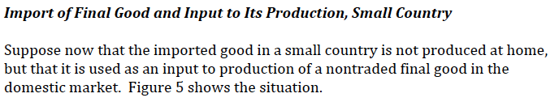

Slide 29
  Questions (not asked before)
What, if anything, does this analysis tell you about the effects of Trump’s tariffs on steel and aluminum? Aside from producers of the metals themselves, who is hurt and who is helped?

Slide 30
Outline
Large country tariff
Differentiated-Product Import, Small Country
Import Input to Production of Final Good
Tariff on Imports from One Country but Not Another

Slide 31
Tariff on One Country but Not Another
with foreign countries exporting imperfect substitutes
Imports from Country B
Imports from Country C
$$\left. (1+tB\right)P_{0}^{B}$$
a
b
$$S_{}^{B}$$
$$P_{0}^{C}$$
$$S_{}^{C}$$
$$P_{0}^{B}$$
$$D^{MC}\left(P^{C},P_{1}^{B}\right)$$
$$D^{MB}\left(P^{B},P_{0}^{C}\right)$$
$$D^{MC}\left(P^{C},P_{0}^{B}\right)$$
Welfare Effects of Tariff on B:
Dom pvt –(a+b)
Dom gov’t +a
Dom cty –b
Figure 6
Tariff on imports from only Country B,
imperfect substitute for imports from Country C

Slide 32
Pause for Discussion

Slide 33
  Questions
Trump levied large tariffs on exports from China.
  Based on this analysis, what would you expect the effects of those tariffs to be
    On the exports of China?
    On the exports of other countries?
  How would it be different if foreign export supply curves were upward sloping?
  How would it be different if imports from other countries were perfect substitutes?

